Slide 1
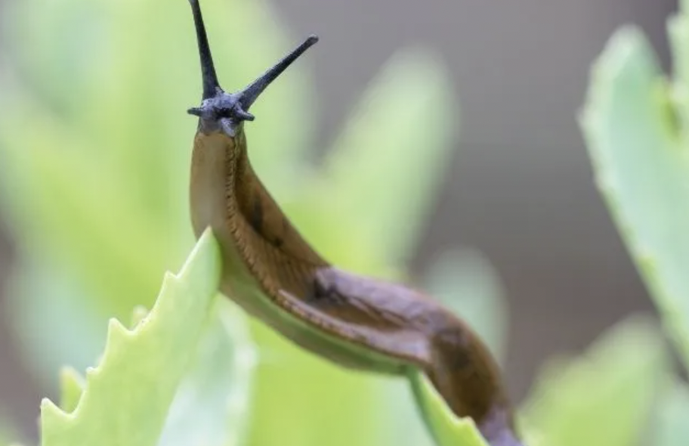
Lab 3: Introduction to Excel and Nematode Experimental Set Up

Slide 2
Housekeeping
DUE TODAY
Lab 3 pre-lab – Experimental Design Outline
Figure Facts Assignment
Your slug!
DUE NEXT WEEK
Lab 4 pre-lab
Annotated Bibliography
ONGOING
Skills Demos

Slide 3
Agenda
Lab Introduction
Introduction to Microsoft Excel
Gastropod Identification and Data Collection
Plating Feces for Nematode Extraction
Group Experimental Design

Slide 4
Due next week by lab: Annotated bibliography
Purpose: create document of sources to cite for your projects.
Each person adding one source means each person only has to read one paper!
Find an article related to your experiment (Note: this cannot be the same article you read for your previous assignment).
Google scholar and the library are good sources
It should not be a review.
What is NOT a review? It should have a methods section
Work through the assignment on Canvas, add to both the assignment submission and your group

Slide 5
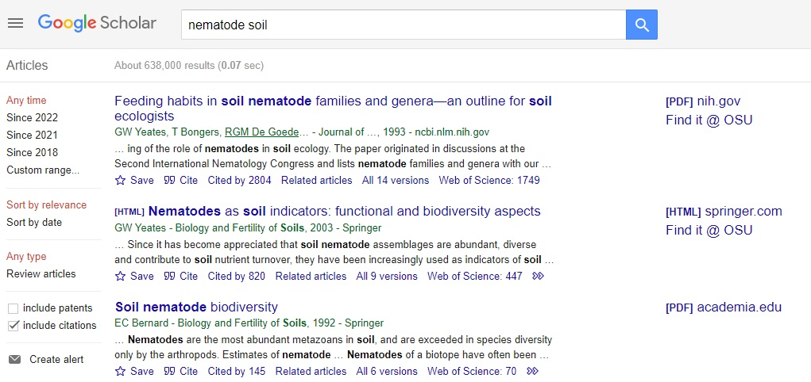
Due next week: Annotated bibliography
Step 1: Find an article related to your experiment (Note: this cannot be the same article you read for your previous assignment).
Google scholar and the library are good sources
It should not be a review.
It should have a methods section
Notes:
Here, I just want to show students how to determine what articles they have access to

Slide 6
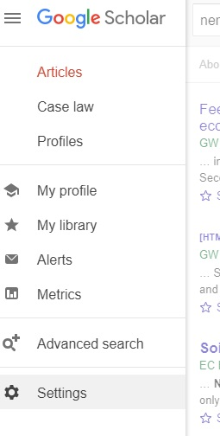
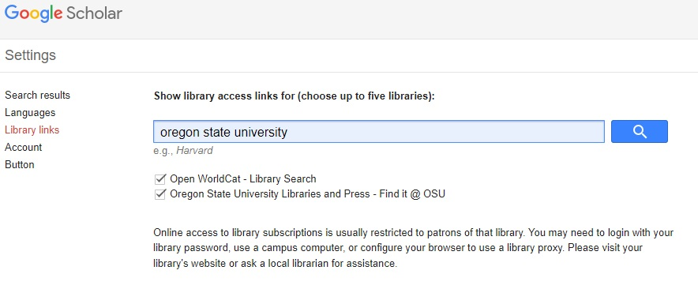
1
3. Library links
2
4. Search Oregon state university, select, and save

Slide 7
What goes in the annotated bibliography?
Citation (Frontiers in Ecology And Evolution)
General topic/context
Objectives and new methods (these might be confusing and that’s okay)
Major results
1-3 sentence synopsis
How it’s relevant to your project
Entire assignment can be quite brief. Approx 1 page
FOLLOW THE FORMAT. (-1 for incorrect format)
See example provided in the assignment description under ‘Grading Criteria’

Slide 8
What I will accept as a proper citation.
Authors names, starting with last name.
Year published.
Entire title.
Journal abbreviated.
Volume,
(Issue):
Pages-

Slide 9
Journal article
GENERAL FORMAT
Authors listed with last names followed by first initial(s). Year of publication. Title. Journal published in journal edition(volume if there is one): pages.
EXAMPLES
Example with one author: Lynn B. 2022. Cats are incredible, but especially Pancake. The Journal of Cats Are Awesome 2: 23-46.
Example with two authors: Pride W and Lightyear B. 1995. To infinity and beyond. The Secret Life of Toys 11: 22-33.
Example with three authors: Potter H, Granger H, and Weasley R. 2000. How to tickle a whomping willow. The Journal of Advanced Magic 6: 26-42.
Example with greater than three authors: Brown M, Bunton E, Halliwell G, et al. 1996. Spice up your life. Wannabe Journal 97: 1-33.

Slide 10
Book / book chapter: Use this format to cite your lab manual.
GENERAL FORMAT
Authors listed with last names followed by first initial(s) – editors listed last and followed by (Eds). Year of publication. Title of book chapter (ignore if citing whole book). In: Title of Book. Publisher city, State: Publisher.
EXAMPLES
Example with one author and one editor: Lynn B and Schmo J (Eds). 2022. Cats are incredible, but especially Pancake. In: The Book of Cats Are Awesome. Corvallis, OR: PublishersRUs.
Example with greater than three authors (BI222 lab manual): Kayes LJ, Harjoe C, Buck J, et al. 2022. Lab 4: Plant Growth and Physiology I. In: Structure and Function of Organisms: Lab Manual for BI222: Principles of Biology: Organisms. Plymouth, MI: Macmillan Learning Curriculum Solutions.

Slide 11
Website
GENERAL FORMAT
Authors listed with last names followed by first initial(s) – author might be an organization or a person. Year of publication. Title of website. Website URL. Viewed date.
EXAMPLES
Example with one author: Lynn B. 2022. Cats are incredible, but especially Pancake. www.bryanlovescats.com. Viewed 15 Jan 2022.
Example with an organization as an author. NSF (US National Science Foundation). 2010. National Science Foundation Does Cool Science. www.nsf.gov/wedothecoolestscience. Viewed 25 Oct 2021.

Slide 12
Example Annotated Bibliography
Citation
Berg EE, Henry, JD Fastie, CL, De Volder, AD, and Matsuoka, SM. 2006. Spruce beetle outbreaks on the Kenai Peninsula, Alaska, and Kluane National Park and Reserve, Yukon Territory: Relationships to summer temperatures and regional differences in disturbance regimes. For Ecol and Manag 227, (64): 219-232.
Topic –Climate Change, Growth Release,
Context
Following a massive spruce beetle outbreak in the 1990 across western North America, there is a poor understanding of factors contributing to these outbreaks since they appear to be different from historic outbreaks (i.e. not a result of disturbance and extensive size).
The objectives of this paper were to use dendrochronological reconstructions of spruce beetle outbreaks to 1) estimate the timing, magnitude and extent of spruce beetle outbreaks, 2) estimate the return interval of spruce beetle outbreaks, and 3) compare spruce beetle disturbance regimes between maritime Alaskan forests and interior Yukon Territory forests. Another objective was to test the hypothesis that the occurrence of regional outbreaks of spruce beetles in 1971-2003 were related to warm summer temperatures.
Notes:
Emphasize using this format! It will make it easier to grade.

Slide 13
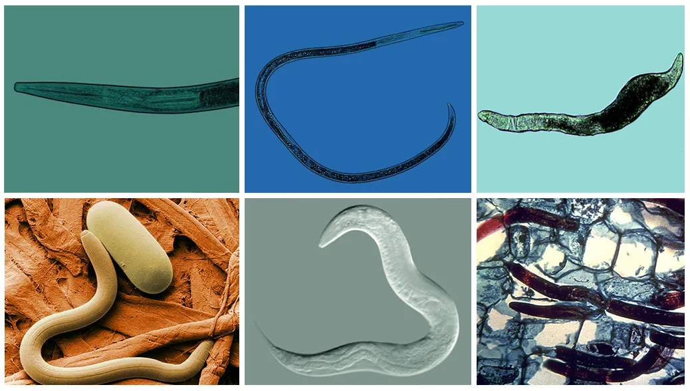
Term Project (group and individual)
Nematode experiment
Design an experiment about nematodes and slugs (today!)
Question, hypothesis, and prediction
Variables
Response - # of nematodes (abundance), size of nematodes, species of nematodes (richness), mouthpart structure of nematodes, movement patters of nematodes (fast/slow)
Explanatory – slug collection location, slug species, slug length, slug, weight
Design, then set up experiment
Data collection (In the future)
Species abundance/diversity
Genetic diversity
Scientific Communication Project (Individual)

Slide 14
Term Project (individual)
Create a Science Communication Product
Target a general audience
Visually engaging
Must address:
A brief description of nematodes and why they are important.
Your question, hypothesis, and prediction.
A basic description of your experimental design, including a clear description of your treatments/conditions.
A description of your major results.
A conclusion that ties your results back to your question, hypothesis, and prediction, as well as to other peer reviewed literature.
Details and examples can be found on Canvas
Draft (lab 6)
Peer review (lab 6)
Final (lab 7)

Slide 15
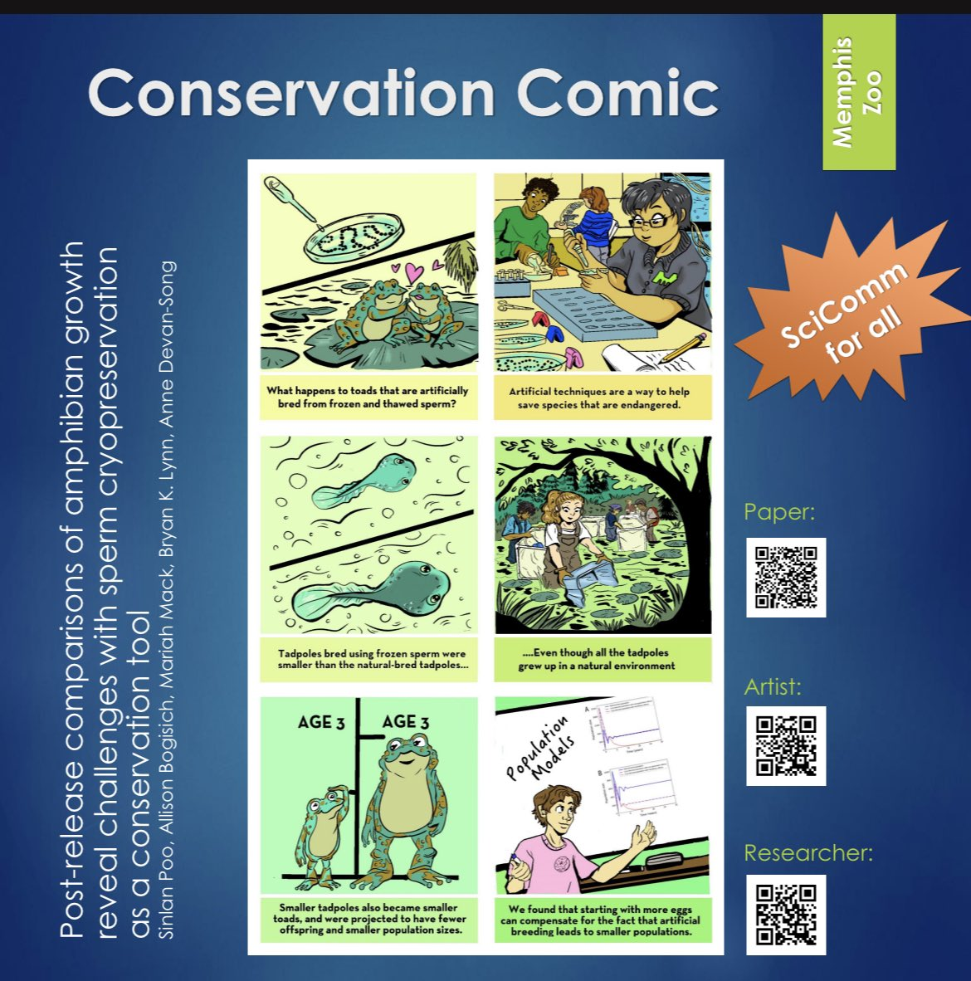
Term Project (individual)
Digital Media
Short video
Animation
Webpage
Illustrated submission
Pamphlet
Graphic Novel
Other audio/visual
Song
Art

Slide 16
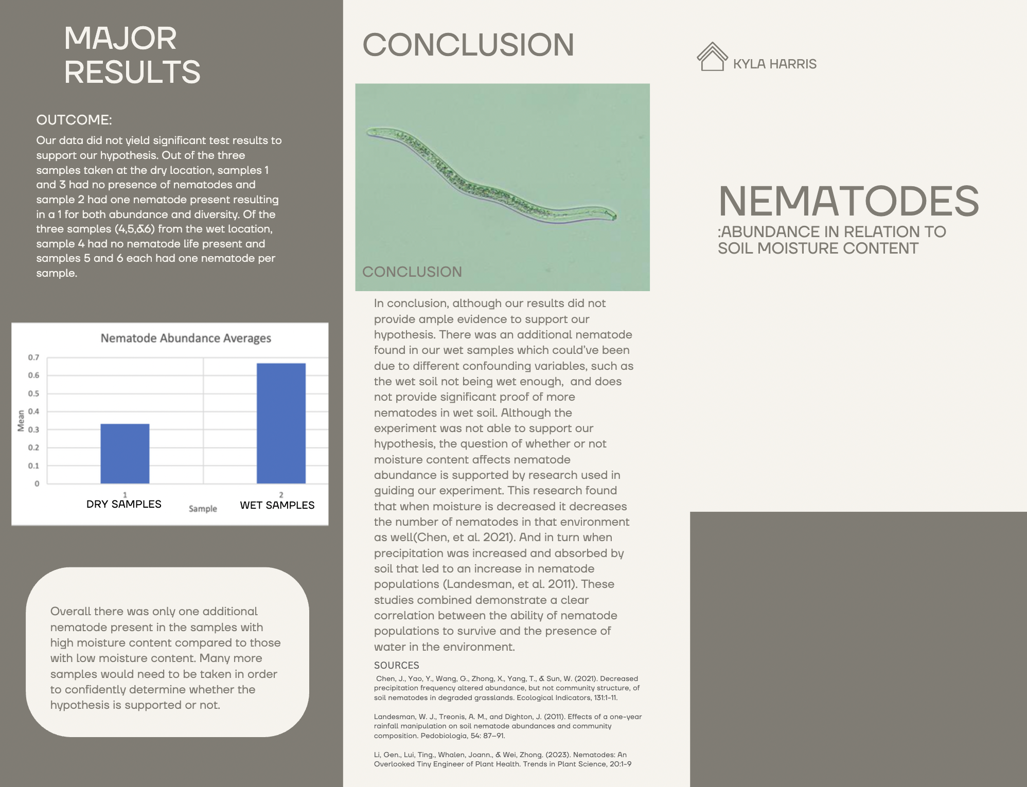
A Nematode Pamphlet
Most straightforward option
Plenty of templates

Slide 17
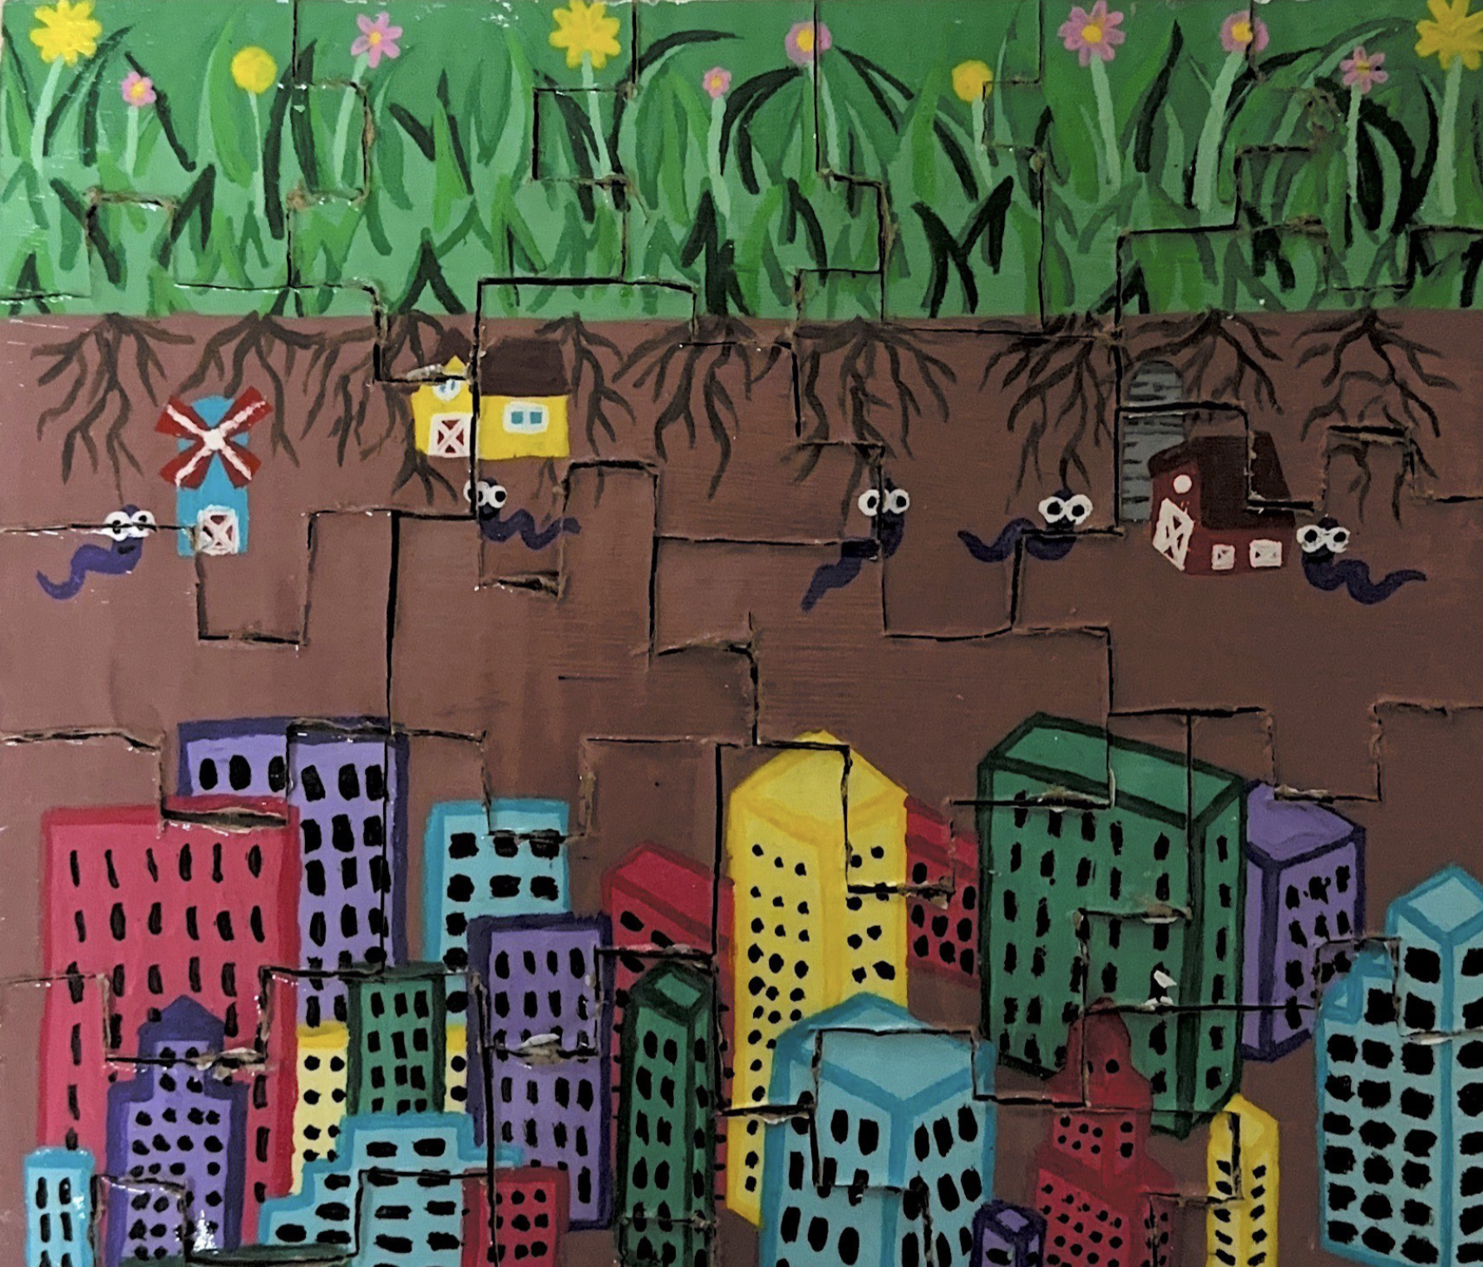
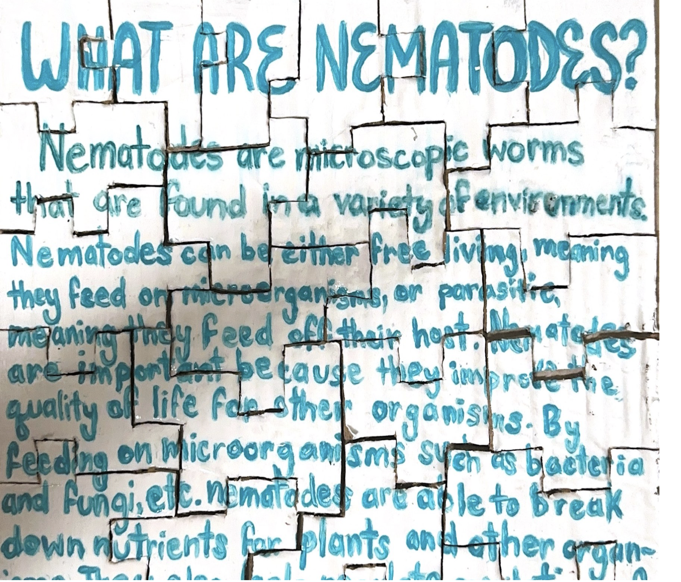
Nematode Puzzle
Image on the front, info on the back!
Video Game: https://www.youtube.com/watch?v=boeYXP4iQm4

Slide 18
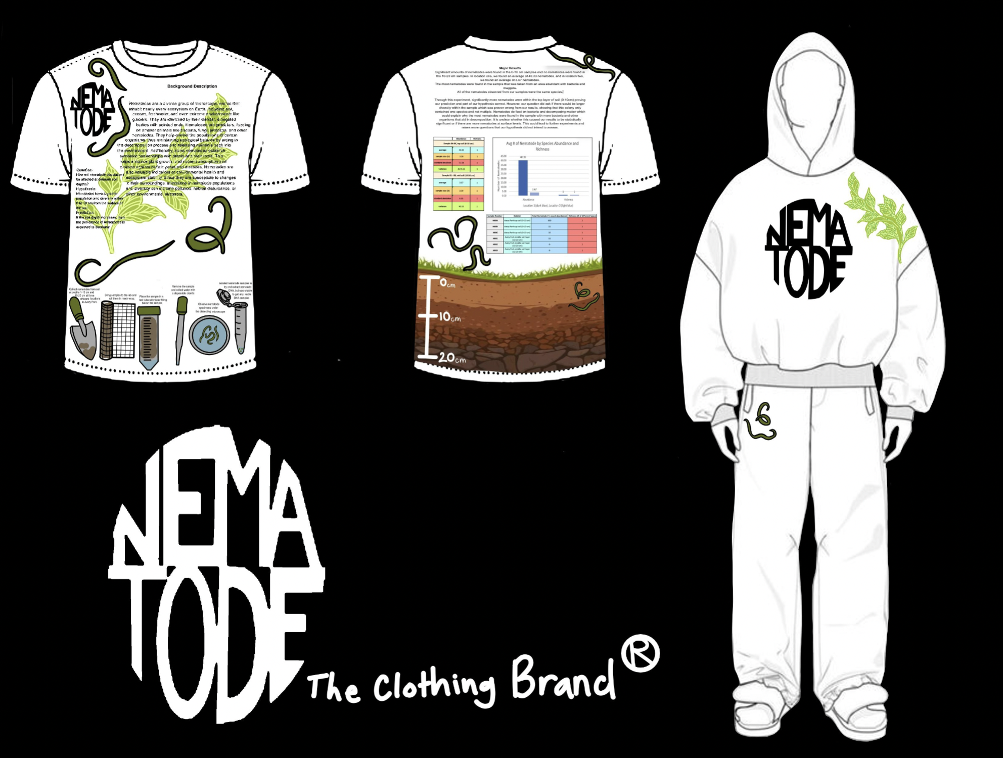
The Nematode Clothing Brand
Note!
Information is all there still

Slide 19
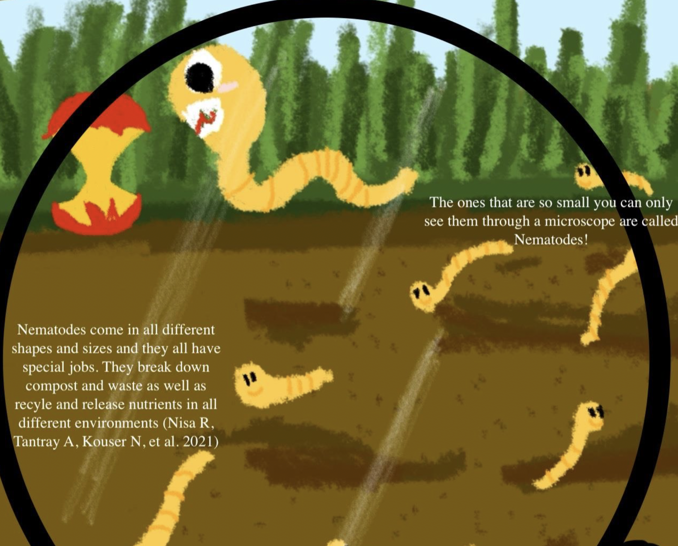
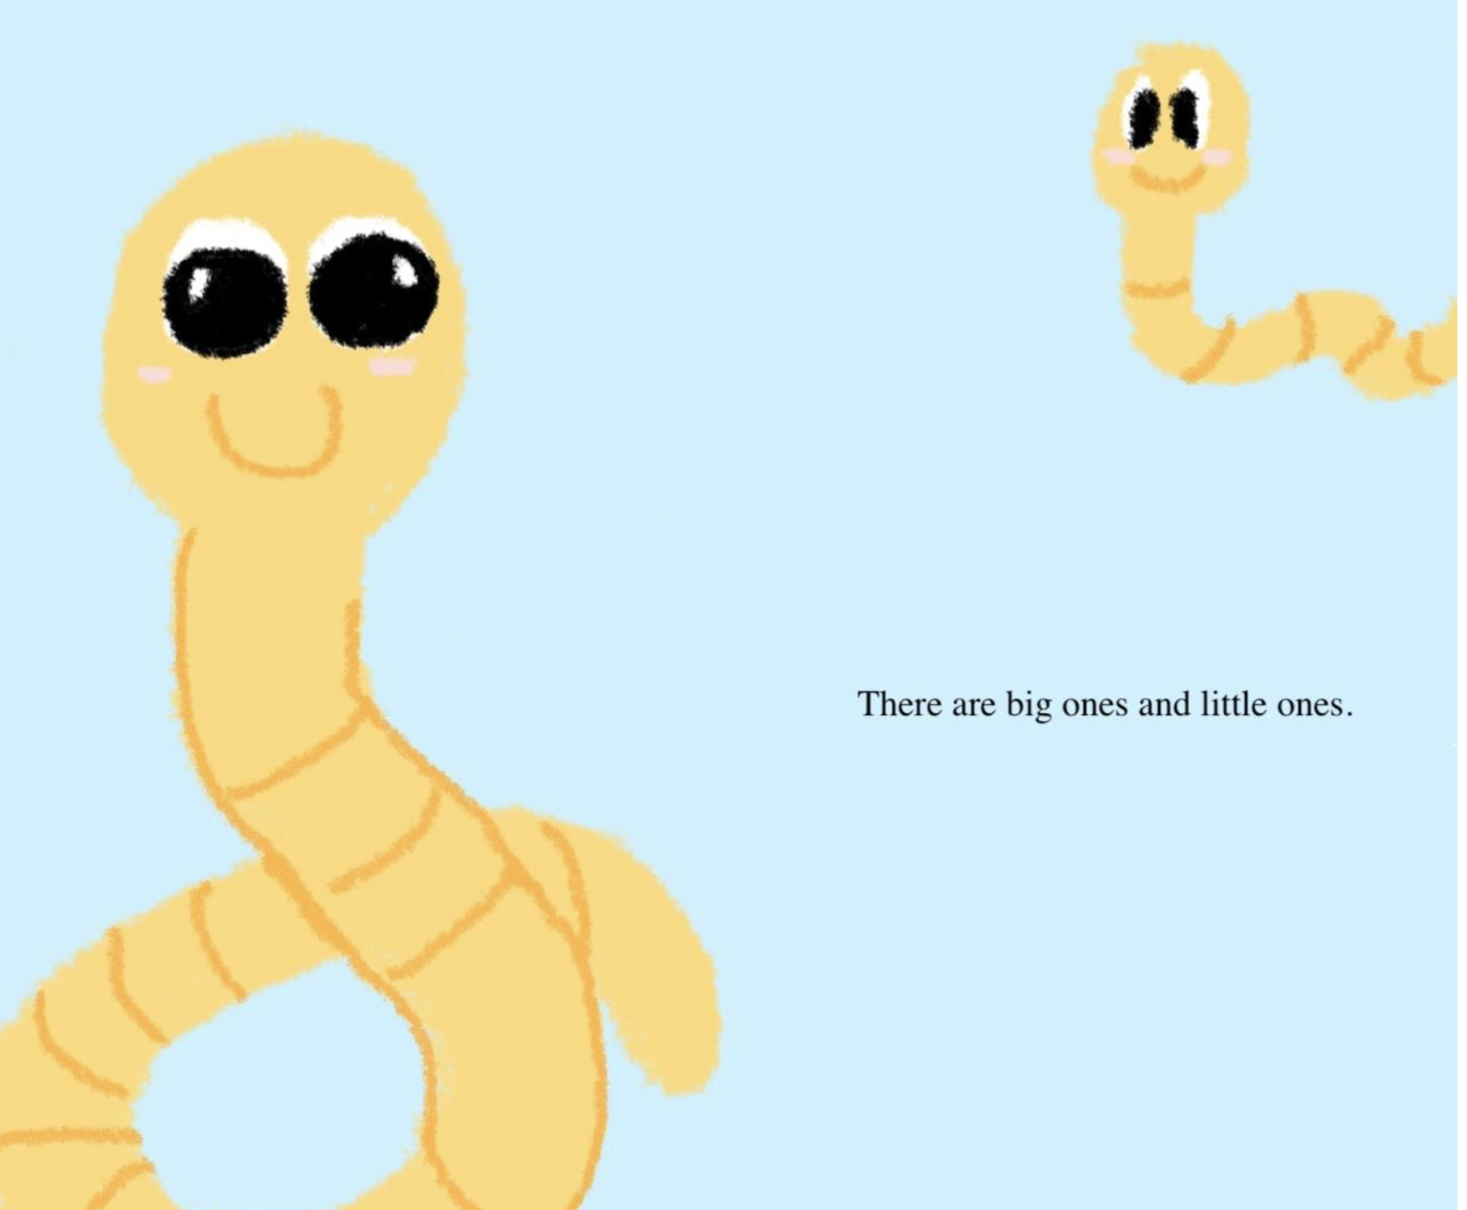
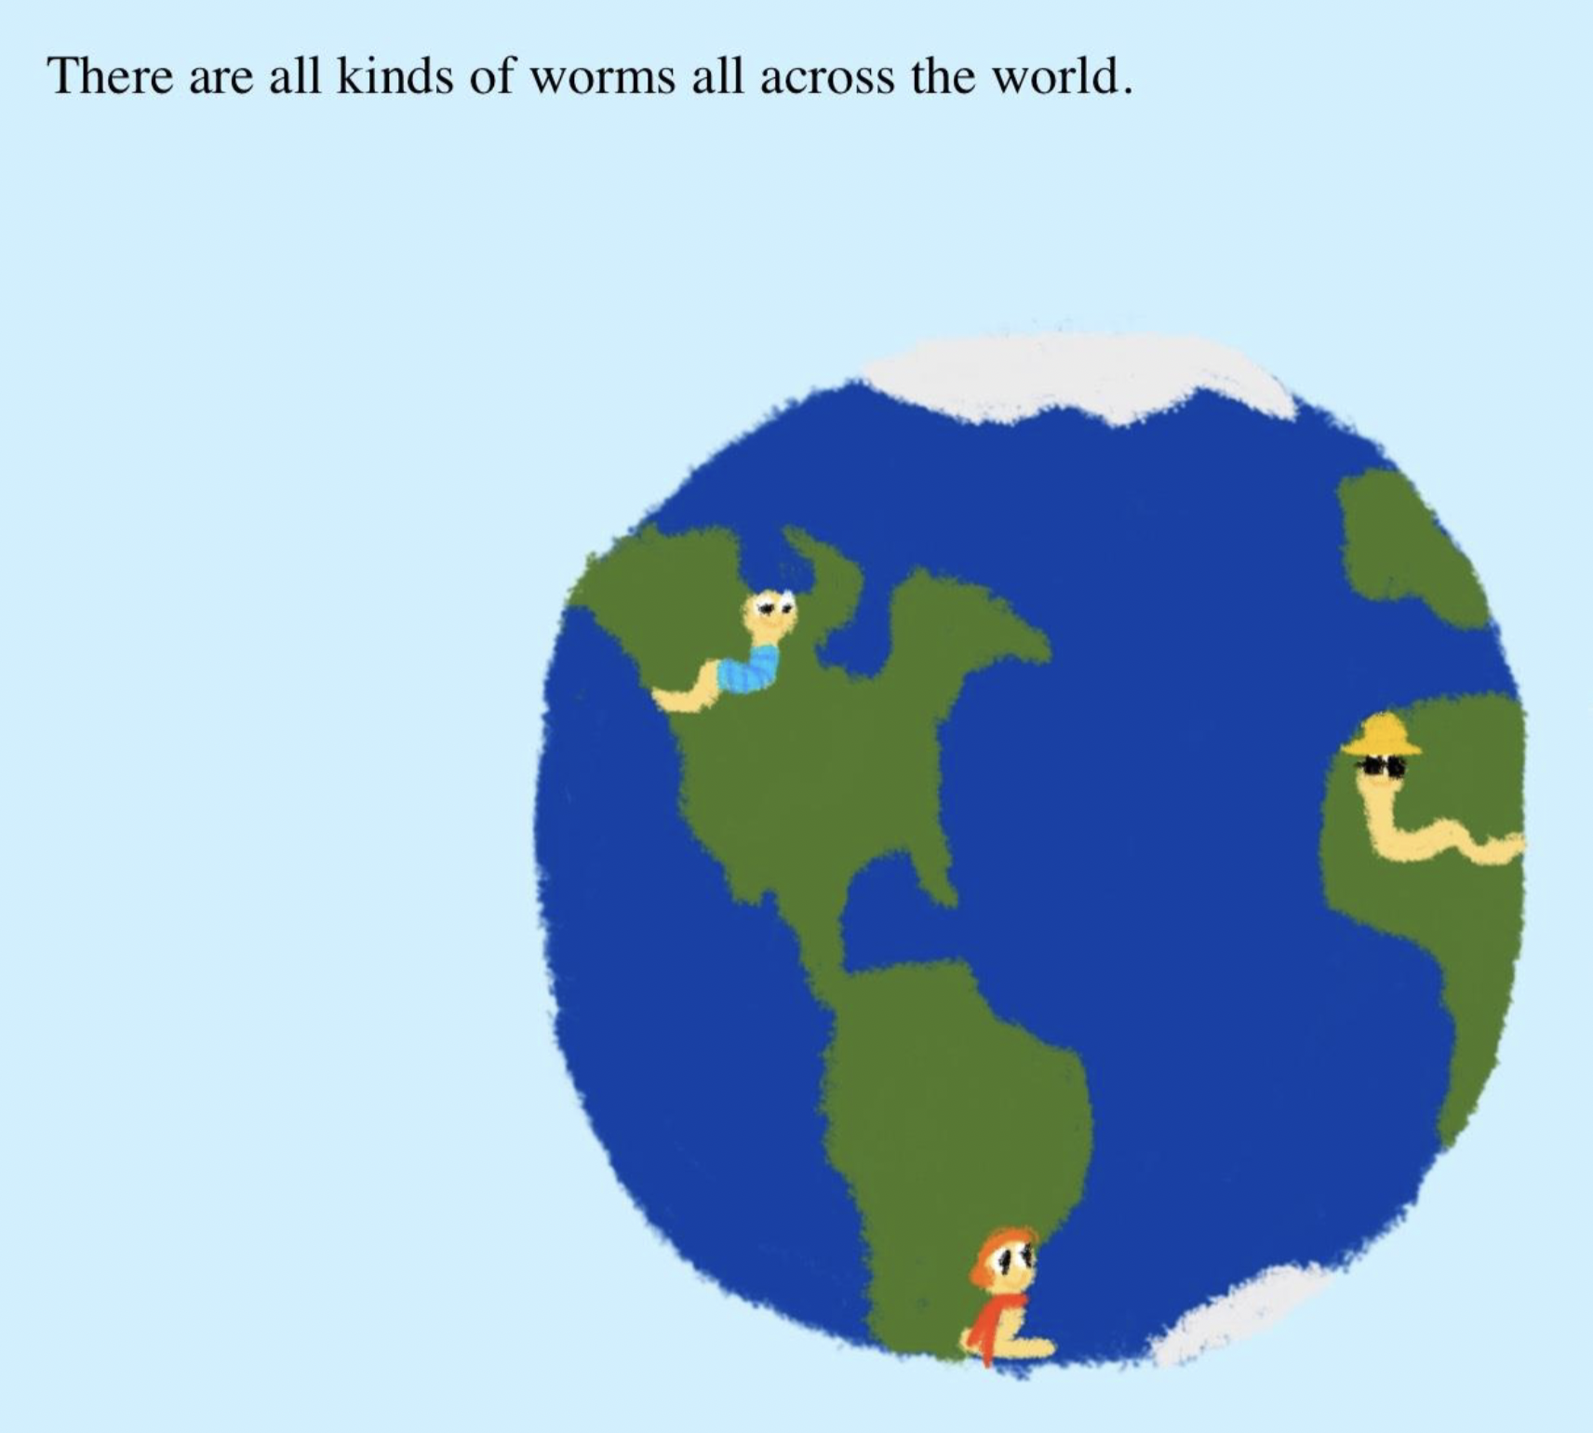
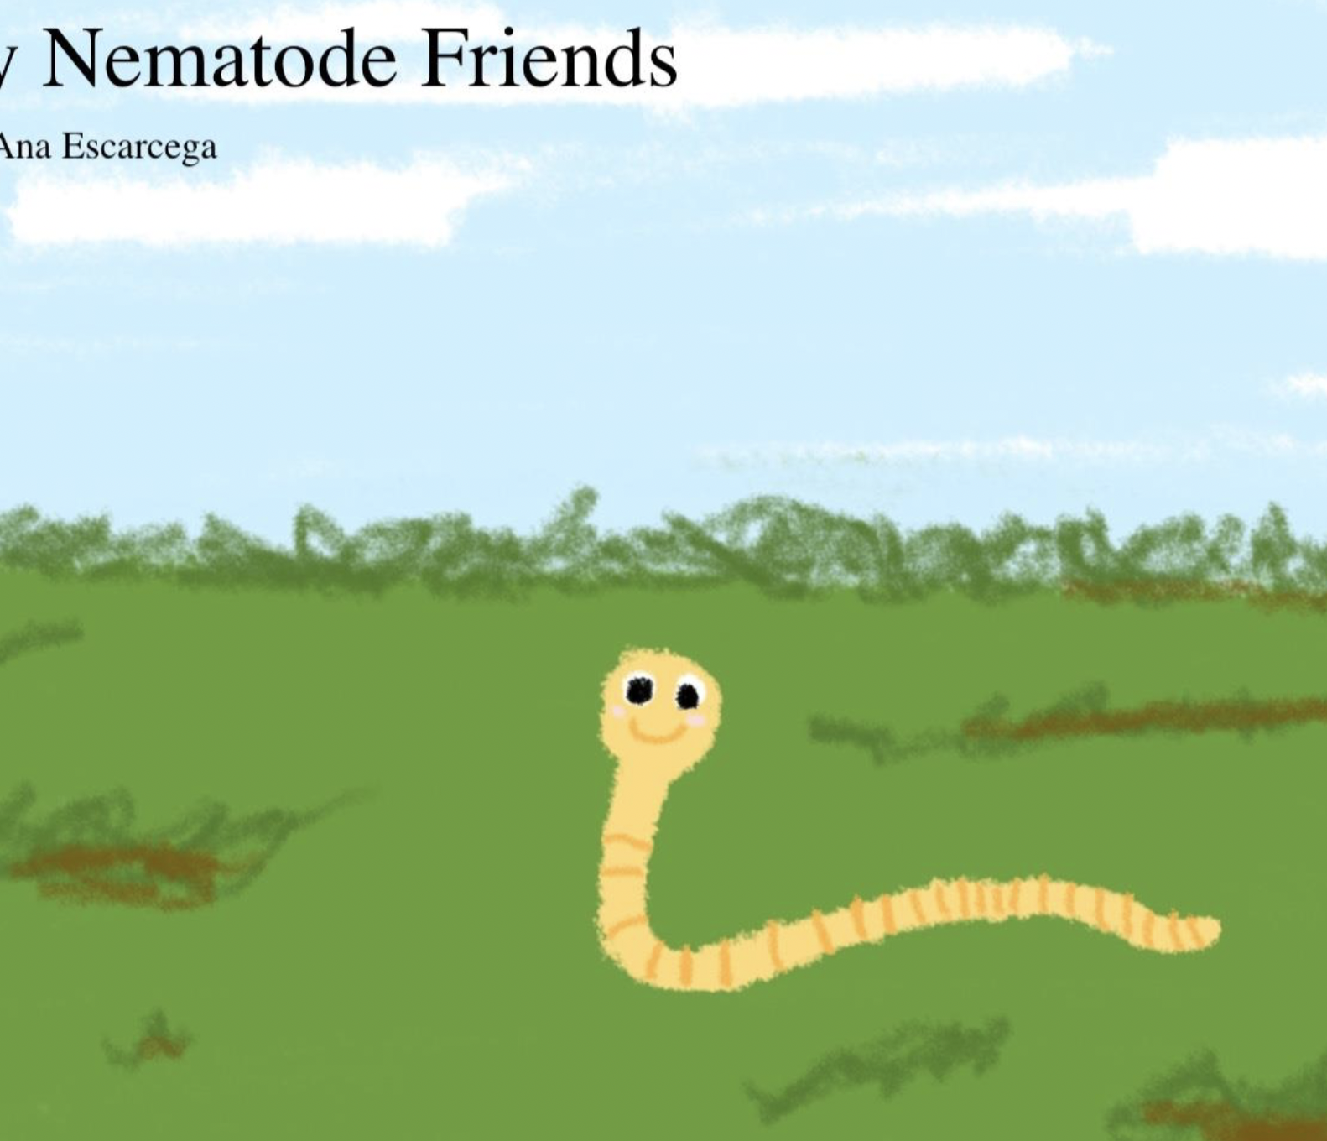
The Nematode Children’s Book!
Note!
Use of in text citations

Slide 20

Questions?

Slide 21
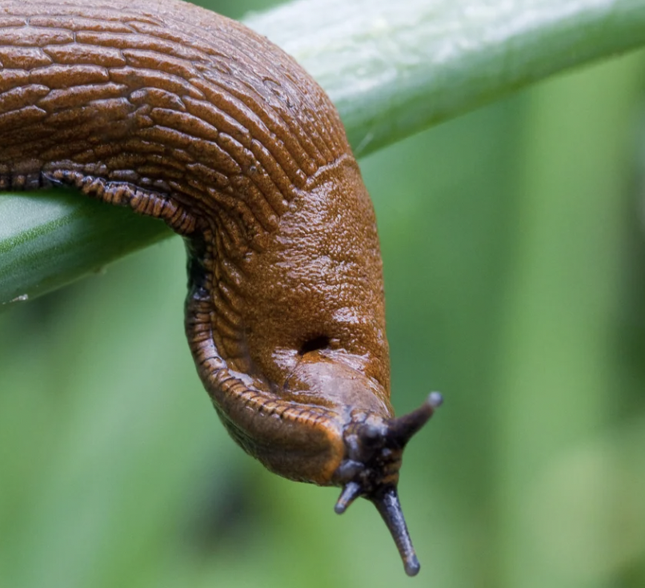
Lab 3: Introduction to Excel and Nematode Experimental Design

Slide 22
Introduction to Microsoft Excel
Why learn Microsoft Excel?
Resume builder!
When is Microsoft Excel useful?
Primarily used for data management, but also very simple data analyses
Notes:
Tas – Use this video to guide your tutorial https://www.youtube.com/watch?v=c2dcRy1X9AA
Excel is a commonly used software across many different disciplines. Used both in academia and in industry for various types of positions.
After leaning some proficiency in this class, you might consider adding this to your resume! This is a very desirable skill.
Many disciples use Microsoft Excel for data management purposes. It’s a really useful way to keep track of lots of data!
You can also use Microsoft Excel for very simple data analyses. However, most disciples use other platforms for analyses. We will introduce you to R and Rstudio, a very common data analysis tool next term in BI 222.

Slide 23
Orientation to Excel (Let’s open it together!)
Open a blank workbook
General Screen Layout
Title bar (top of Excel window)
Ribbon (menu tabs and share)
Name box and formula bar
Main worksheet contains a series of columns and rows
The intersection of a column and row is called a cell
Currently selected cell is called active cell
Worksheet tabs (bottom of screen)

Slide 24
Orientation to Excel (Let’s do it together!)
Entering data
Click on the upper left cell (cell A1)
3 types of data (text, value, formula)
Text – alphabetic characters
Values – numbers or dates
Formula - perform calculations (always begin with = sign)
Together – type some text into cell A1; type some numbers into A2 (1357); in A3 type =1+1 and press enter. What type of data is in A1? A2? A3?
Edit using the formula bar
Now, highlight a range of cells, specifically A1:A3
Notes:
A1 = text; A2= values; A3 = Formula

Slide 25
Part 1: Introduction to Excel
Download the Excel spreadsheets from Canvas under Lab Links
Each of these have several tabs (do you remember how to find tabs?)
Complete each task under the Exercise tab for both Tutorial 1 and 2

Slide 26
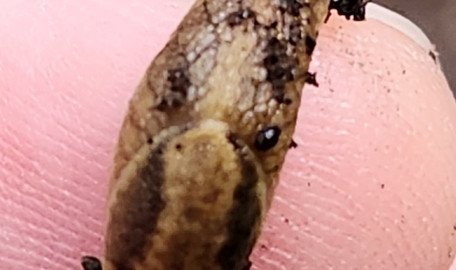
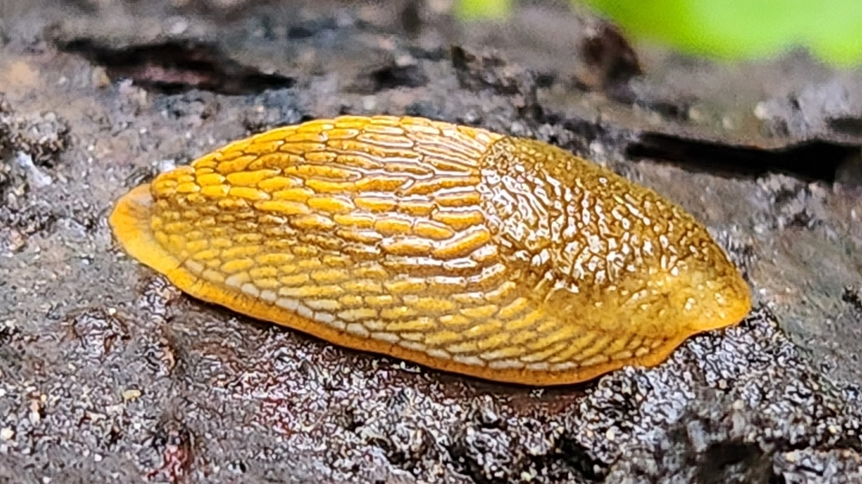
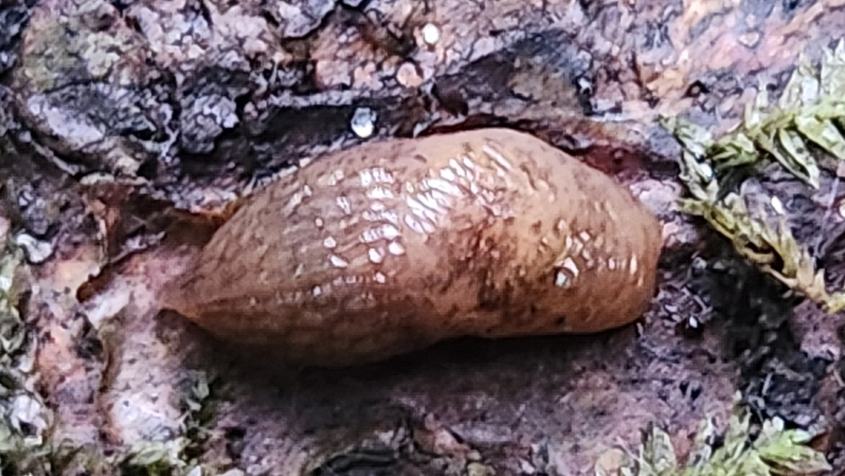
Part 2: Gastropod Identification and Data Collection
Take a picture of the following:
Slug’s right-hand side in lateral view
Slug’s dorsal view
Submit to inaturalist.org
Use Slug Portal to ID your slug!
Record weight and observations
Record in class spreadsheet!
Notes:
Submit these to inaturalist – we have a collaborator here (Casey Richart) who will verify these entries
If they already did it in the field, they don’t have to do this step

Slide 27
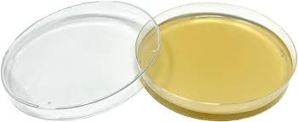
Part 3: Plating Feces for Nematode Extraction
Obtain an agar plate
Wear gloves and practice sterile technique (otherwise your plate will culture mold, bacteria, fungi etc. instead of nematodes)
Use a spatula to transfer feces to plate near the edge
Replace the lid quickly
Seal and label
Label – two digit dection, two digit table #
Example: section 011, table 1 should be 1101

Slide 28

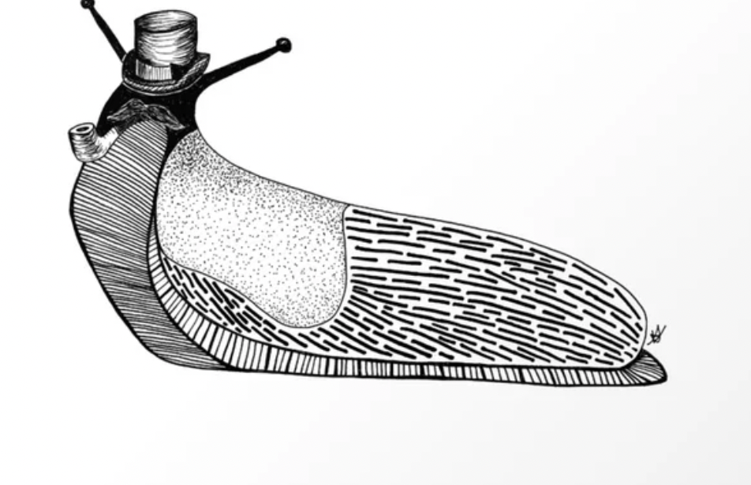
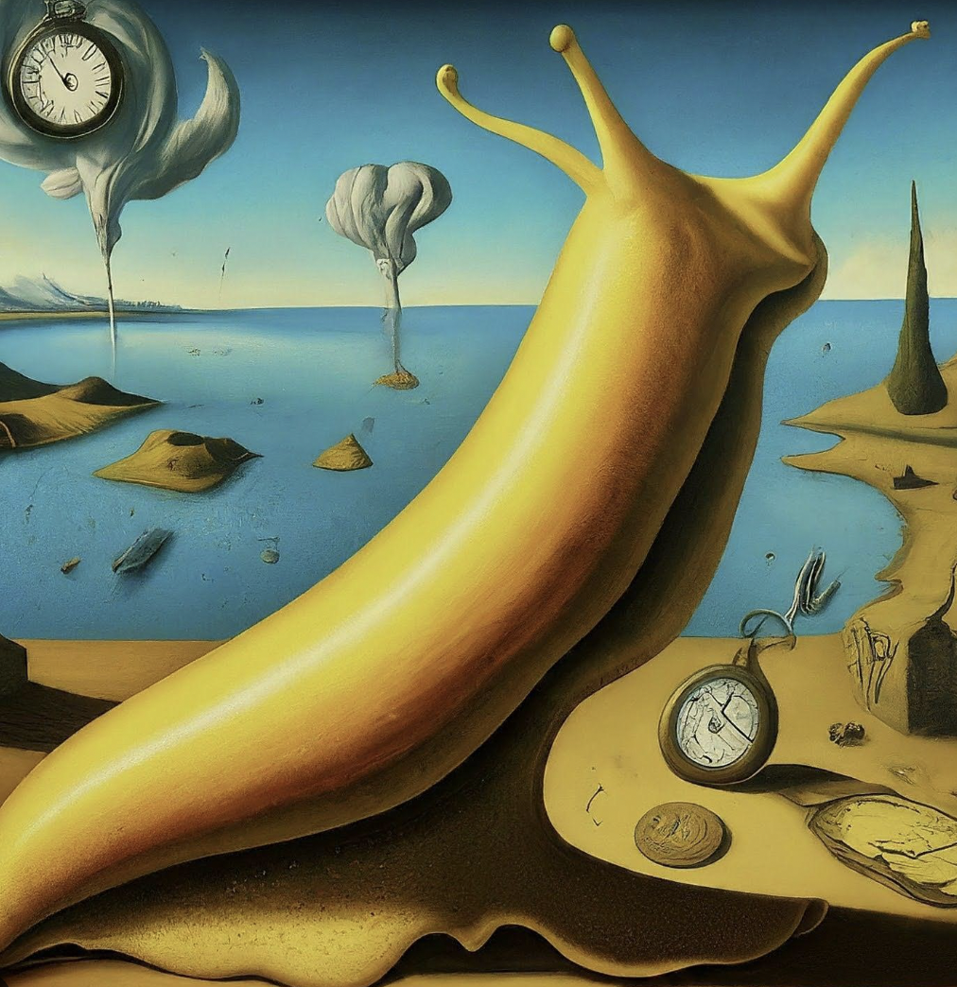
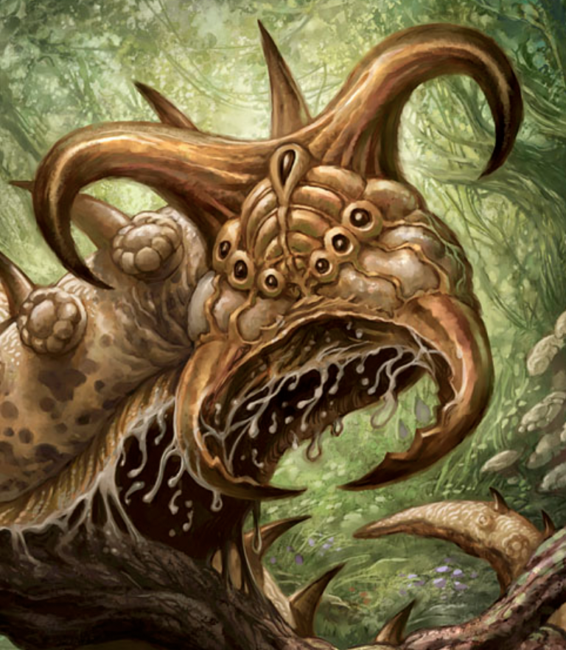
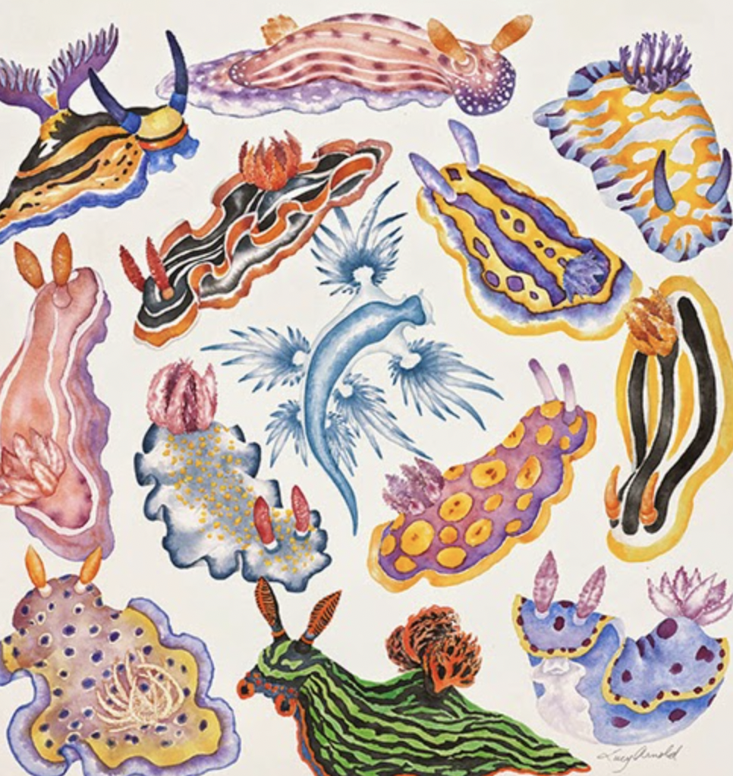
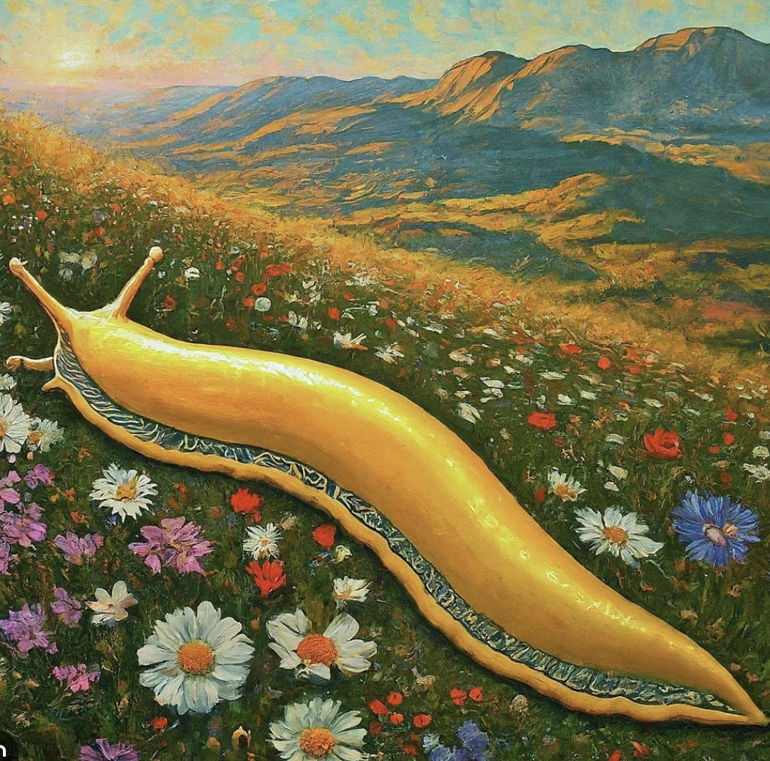
Communicating Science through Art

Slide 29
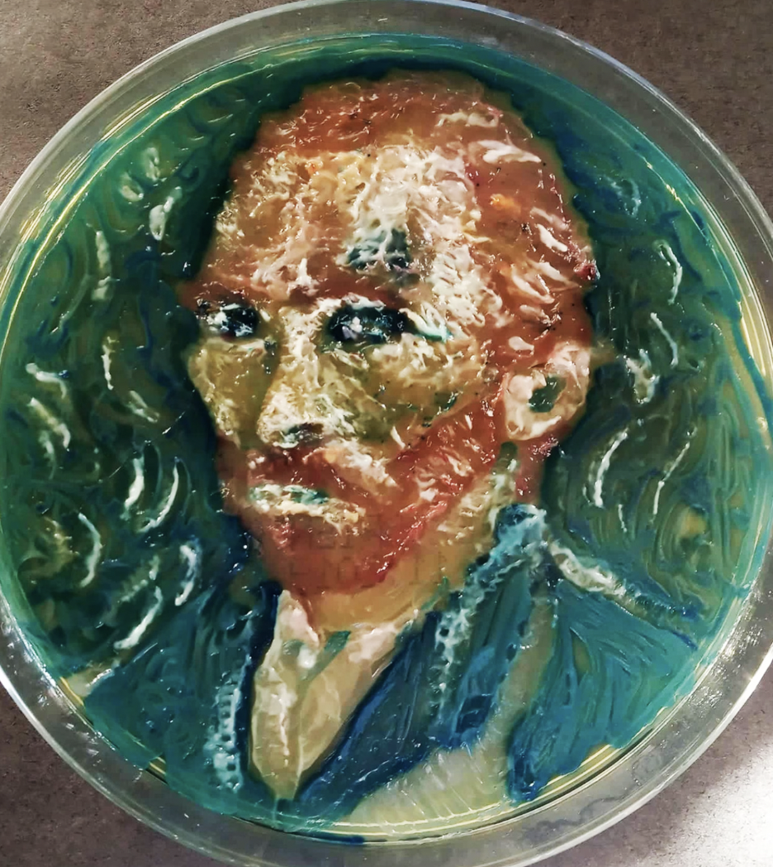
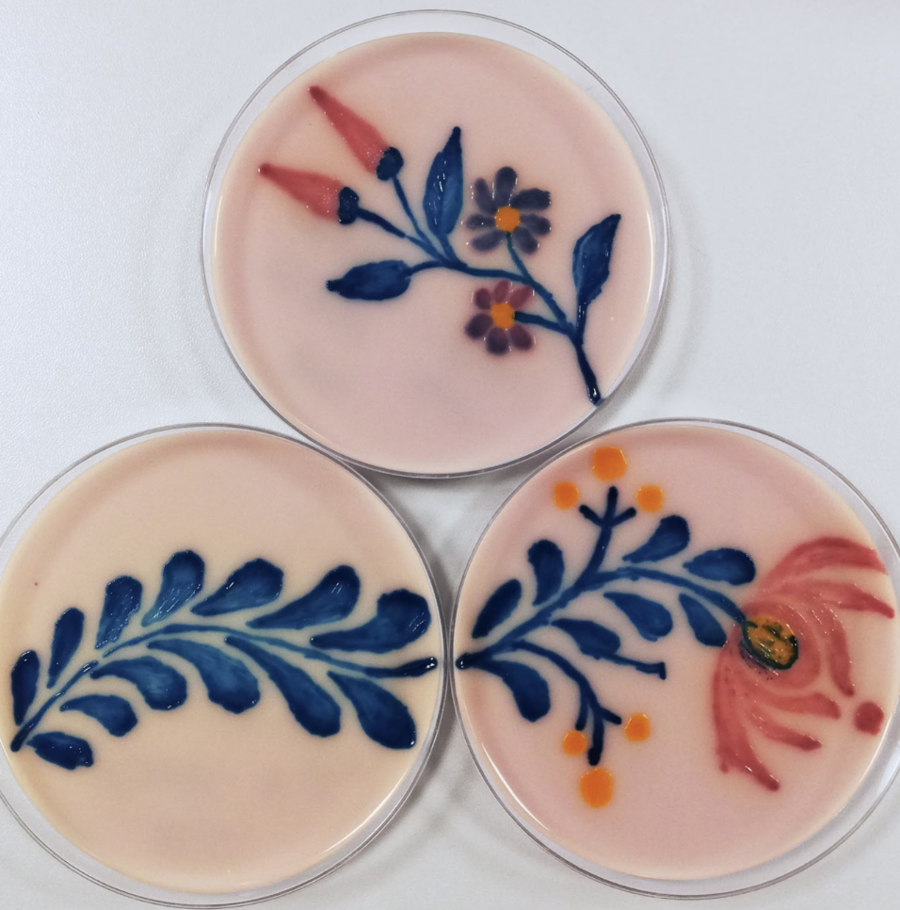
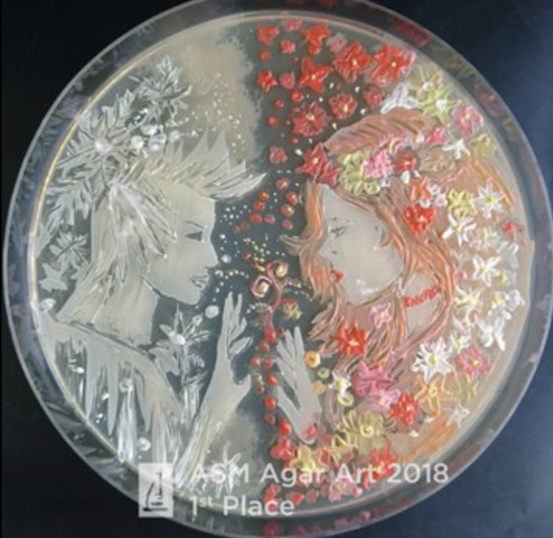
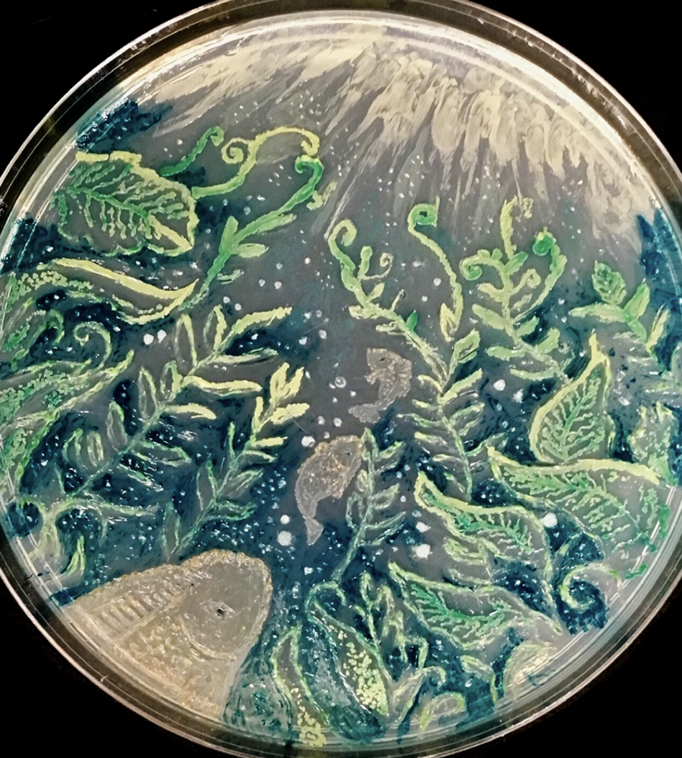
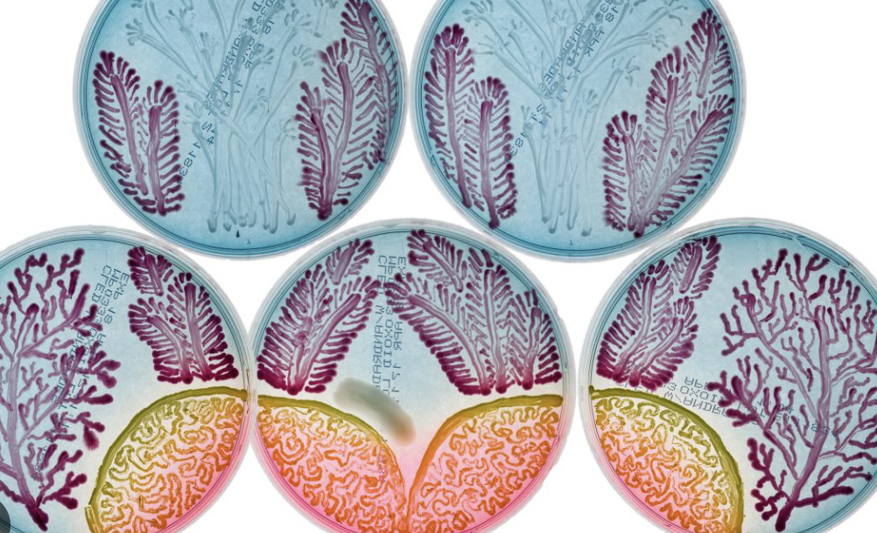
Art on Agar

Slide 30
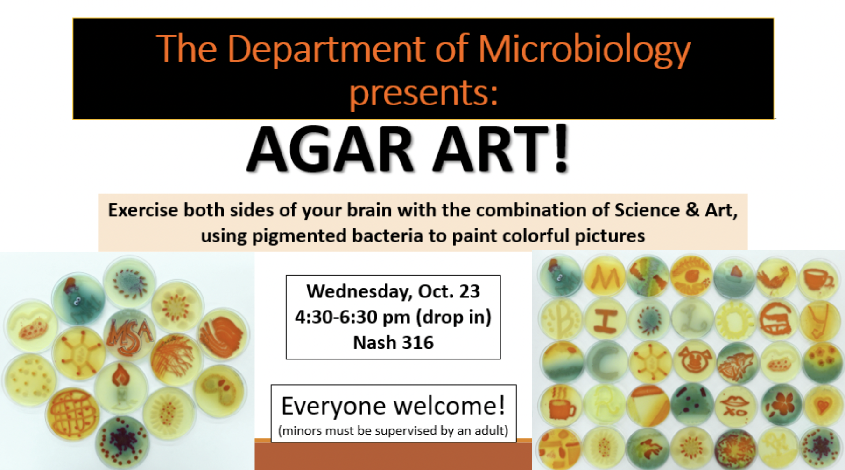

Slide 31
Clean Up
Wash your hands!
Wash the spatula with a lot of soap! Preferably while still using gloves
Return your slug to where you found it
Bring your deli container back with you next week
Remove all trash from your table
Reorganize your tray

